Slide 1
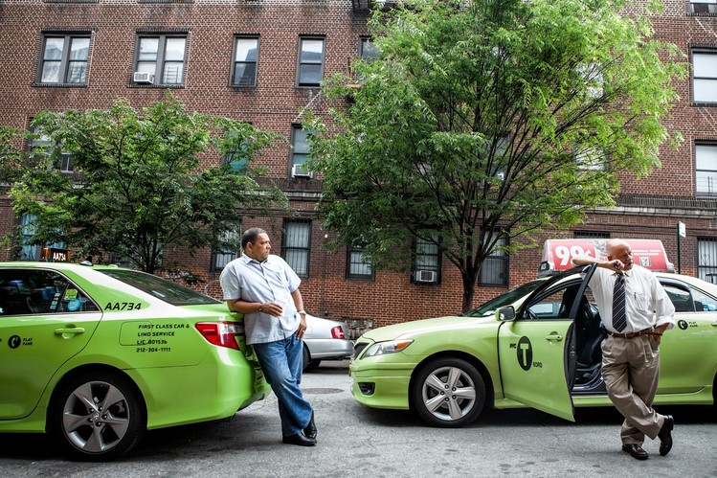
Analyzing New york city’s green taxis
Done by: Ao Yang(1935602), Tristan Mira, Chuan Hao (1922264) and Sheen Hern (1902257)
Source: https://www.wsj.com/articles/green-taxis-gaining-ground-in-new-york-city-1403145481

Slide 2
Business objectives
What affects the demand of green taxis in New York City (NYC)?
Demand -> Number of pickups by green taxis
How are long and short trips different?
Different -> Behaviour/ trends
Long/short trips -> Duration of trips
By our definition, Long trips > 30 mins Short trips < 30 mins

Slide 3
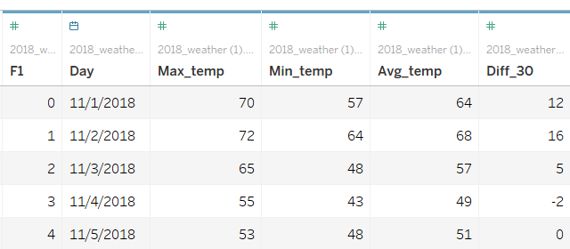
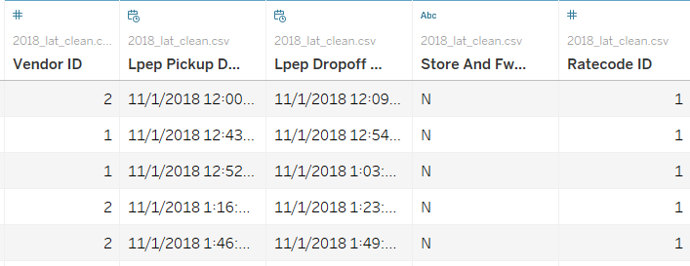
Dataset used (Nov - Dec 2018)
NYC Green Taxis dataset from by NYC open data (Team, N., 2019)
2. NYC weather conditions (Data.cityofnewyork.us., 2019)

Slide 4
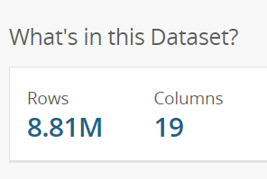
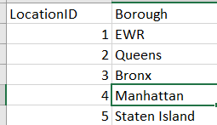
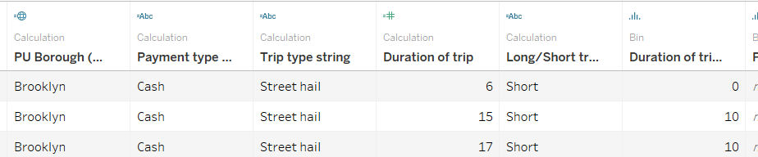

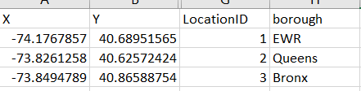
Processing the NYC green taxi dataset
For the NYC green taxi dataset:
Cleaning data
Downsizing the dataset
Mapping geographical locations
Creating calculated fields

Slide 5
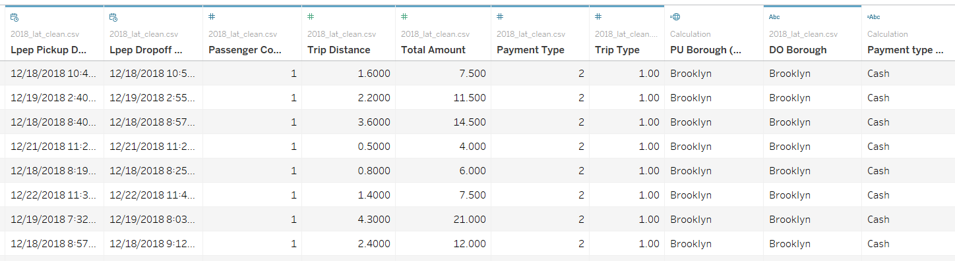
A look at the cleaned data
1.3 Million rows of data
35 Total columns, mainly used 14 columns
Note:
PU = Pickup
DO = Drop off
Borough = Regions/ areas

Slide 6
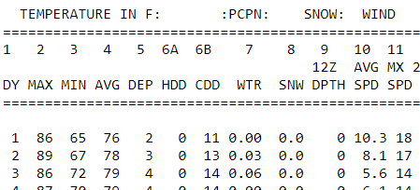
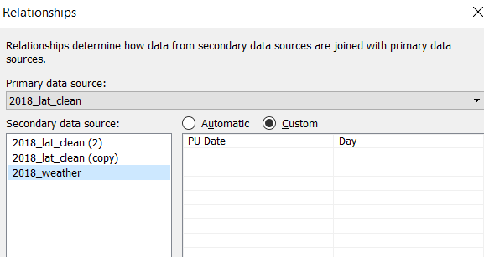
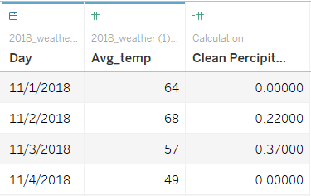

Processing the weather dataset
Turn raw inputs into CSV
Blend the data with the green taxis dataset using datetime
Looking at the data:
Avg_temp -> average temperature
Precipitation -> Amount of rain

Slide 7
1. What affects demand for taxis?
Different Boroughs, different demands
Most demands are split between Brooklyn, Manhattan and Queens (Around 400k trips)
Most trips are within a Borough, with exception of bronx
Around 30% go out of the Borough
Time of day affects demand
Peak and non-peak hours
Also differ by Borough
General trend of 7-8AM peak hours
These periods also affect average duration of trips
Generally, rain and temperature have no significant impact on demand of trips

Slide 8
2. What are the differences between long and short trips?
Distribution of long and short trips differ by Boroughs
Brooklyn has largest number and proportion of long trips
Long and short trips have different peak and non-peak periods
Long trips have peak periods 1H earlier than short trips
Average duration of long trips fluctuate over time, not so much for short trips
Long trips generate significantly more income than short trips

Slide 9
References
1.Team, N. (2019). National Weather Service Climate. [online] W2.weather.gov. Available at: https://w2.weather.gov/climate/index.php?wfo=okx [Accessed 21 Nov. 2019].
2.Data.cityofnewyork.us. (2019). [online] Available at: https://data.cityofnewyork.us/Transportation/2018-Green-Taxi-Trip-Data/w7fs-fd9i [Accessed 21 Nov. 2019].

